Slide 1

Online OTR Verification System for GNDEC

Slide 2
INTRODUCTION
The National Scholarship Portal (NSP) provides a centralized platform for students to apply for various scholarships.
The online One-Time Registration (OTR) verification system for colleges aims to streamline the scholarship application and verification process, reducing manual intervention and improving efficiency.
The proposed system will enable students to register, check their scholarship status, and receive automated notifications upon successful verification and submission.

Slide 3
OBJECTIVES
Design and implementation of a web-based platform for scholarship form submission and verification.
Facilitate students to check the status of their scholarship applications.

Slide 4
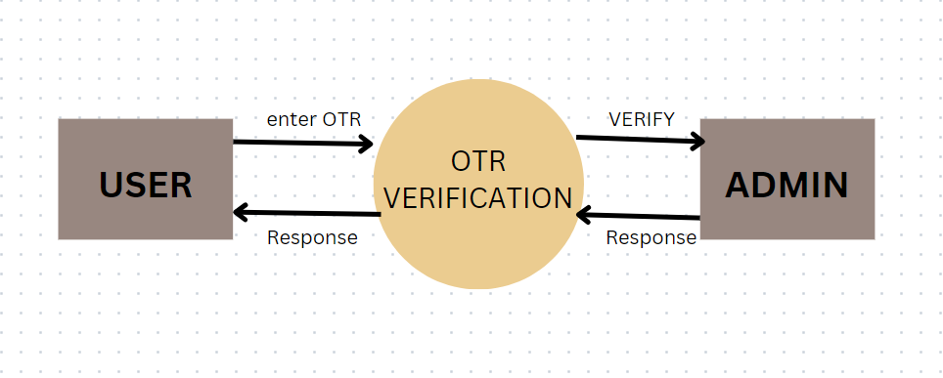
WORKFLOW OF OTR VERIFICATION

Slide 5
OTR UPLOADING PROCESS
Upload OTR Image: Users upload an image (Max: 5MB).
Enter OTR Number: Users enter their unique OTR number.
Submit for Verification: The system checks the document and OTR number for validity.

Slide 6
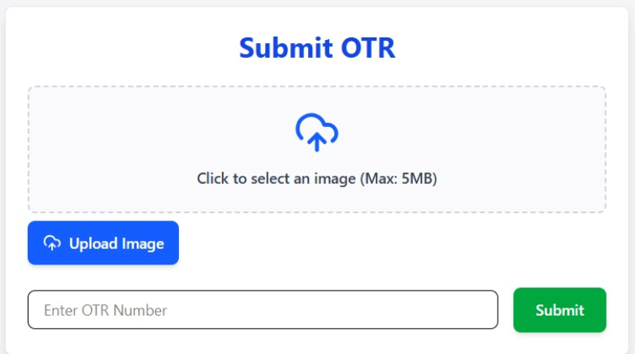
OTR SUBMISSION

Slide 7
FUTURE IMPROVEMENTS
Debug OTR verification process to ensure seamless validation.
Implement better error handling to guide users on submission failures.
Improve UI for a more user-friendly submission experience.

Slide 8
CONCLUSION
OTR simplifies and secures the scholarship application process.
Ensures transparency and efficiency.
Reduces manual verification efforts and speeds up processing time.

Slide 9
THANK YOU!

